Slide 1
Daycare HR Management System
By: Andrei Sinkevich & Gregory Torakis

Slide 2
Daycare HR Management System
Register
Login
Educator
Child
Comments
about kids and groups
CRUD
operations

Slide 3
Daycare HR Management System Makes Managing Your Workday Easy!
Features include:
A mobile optimized online system for 24 X 7 access on any device.
Registration and enrollment.
Full list of children or detailed view, with possibility to leave a comments
List of our professional educators
Comments about groups and kids

Slide 4
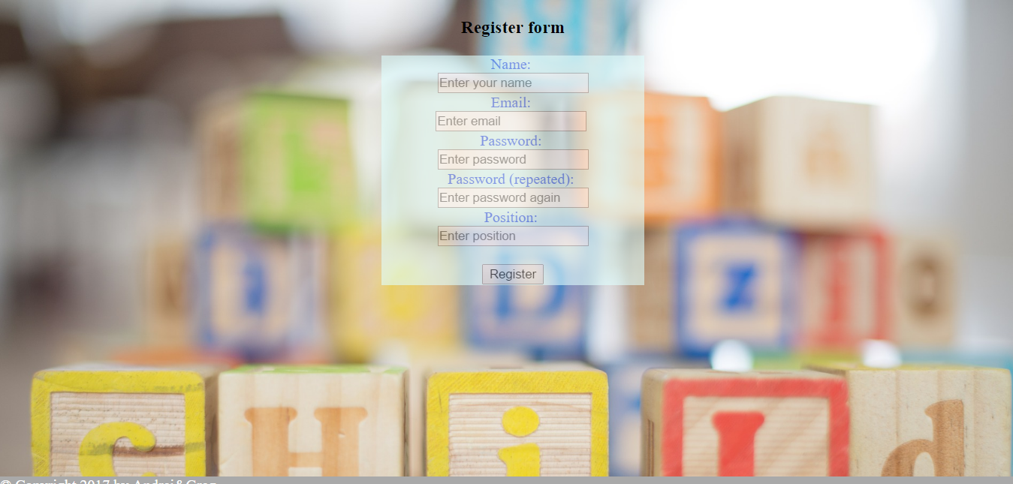
Register form to get an access to the system
Verifying the availability of email
Checking , if passwords are matched

Slide 5
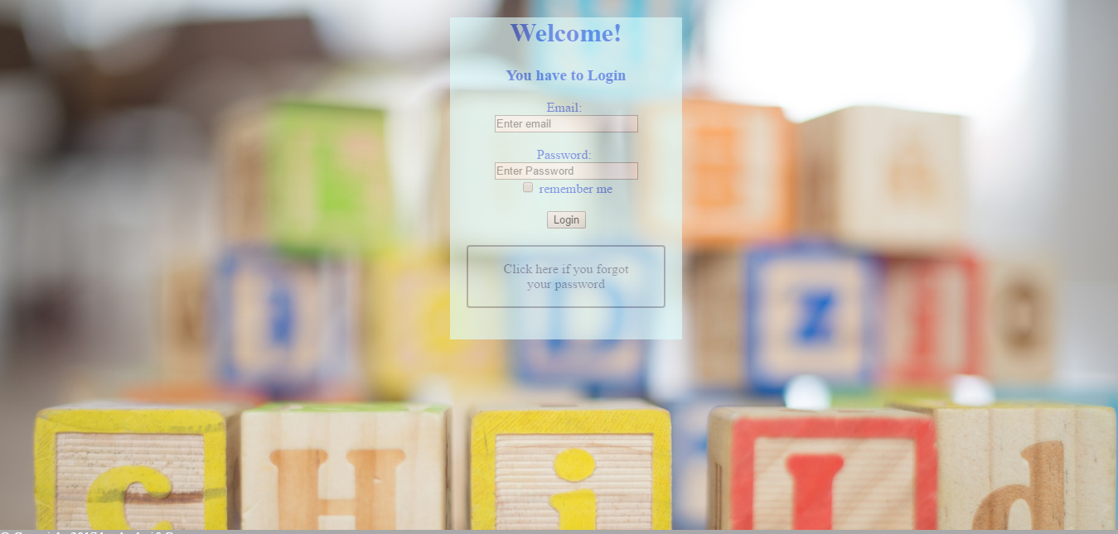
Login menu with password recovery option
Verify email and password
On the back end verify the position
Gives different access depends on the privilege

Slide 6
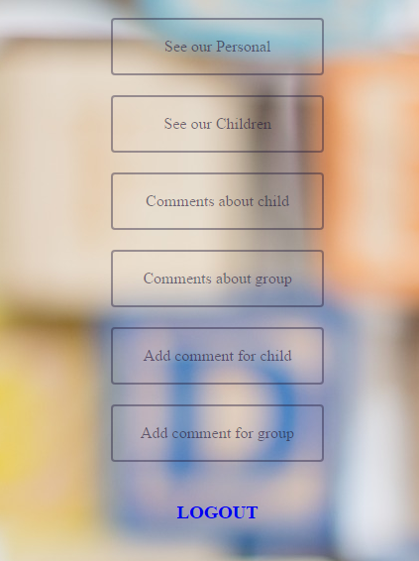
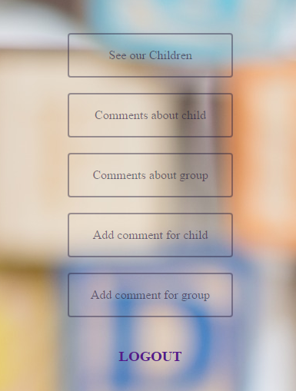
Main page with different privileges: director and educator

Slide 7
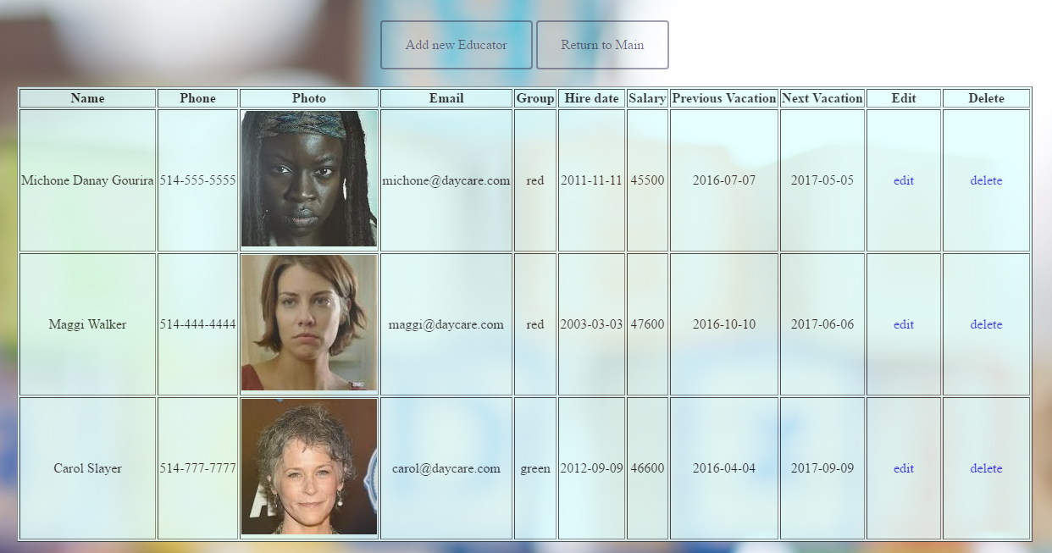
Educators
This list is available
only for
Director of daycare

Slide 8
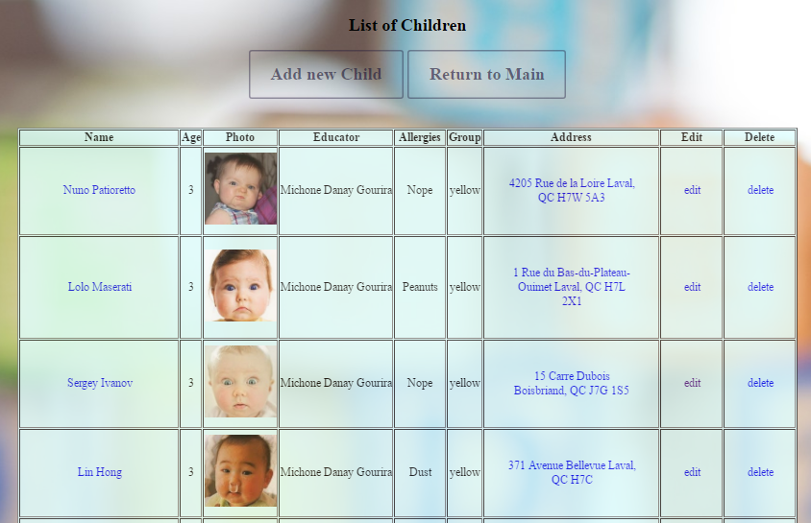
Children – main list of kids

Slide 9
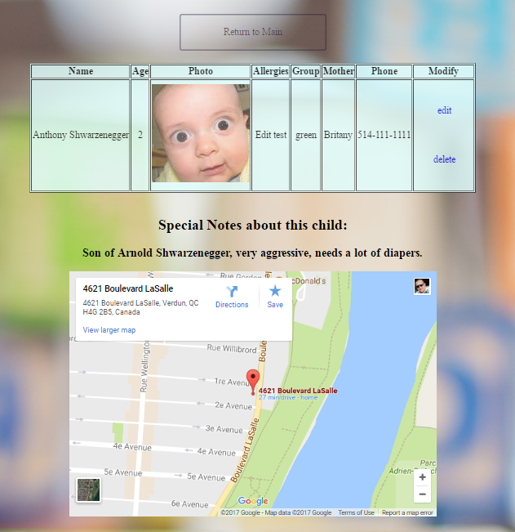
Detailed view of chosen child with embedded address on Google Map

Slide 10
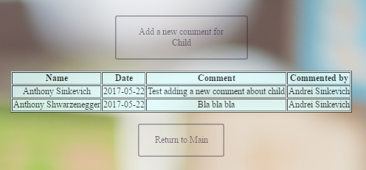
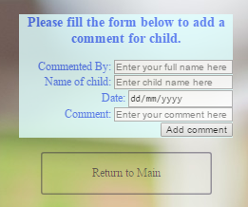
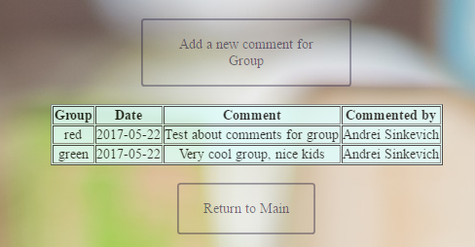
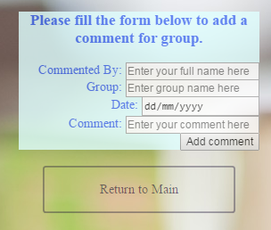
List of comments for kids and groups with the forms to leave a comment

Slide 11
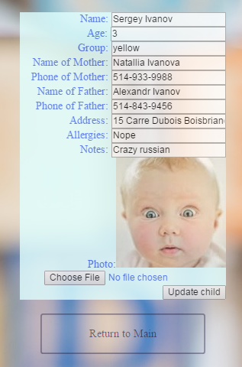
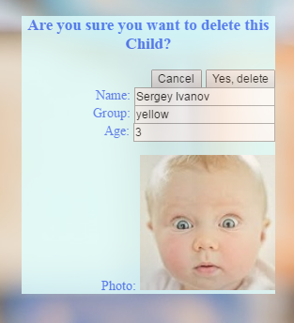
DELETE
MODIFY

Slide 12
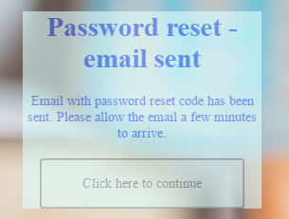
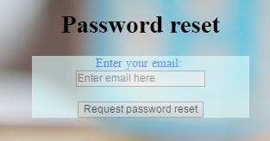
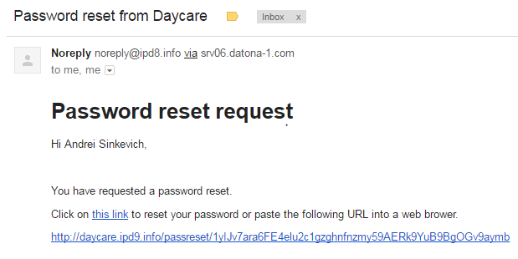
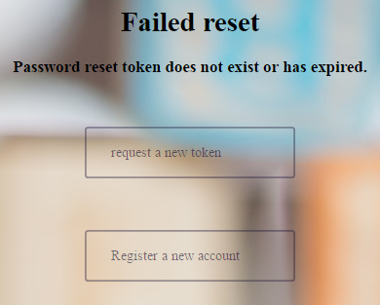
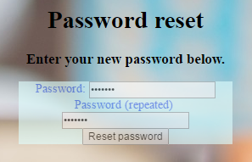
Password Recovery

Slide 13
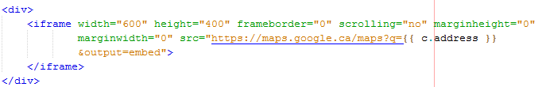
Our Challenges
Embedded Google Map with assigned address
Display the right Educator with child

Slide 14
Future work:
Access for Parents to make a notes for absentees of their child
Possibility of Online Payments

Slide 15
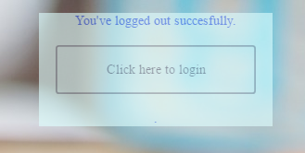
Thank you for watching our presentation

